Slide 1
CSE211 COMPUTER ORGANIZATION AND DESIGN
Lecture #0

Slide 2
Course details
LTP – 3 1 0 [Three lectures and One Tutorial/week]
Text Book
COMPUTER SYSTEM ARCHITECTURE by MORRIS MANO, Prentice Hall of India, 3rd Edition, (2007)

Slide 3
What’s CSE 211 All About?!
Introduction to computer architecture
• How is data represented?
• What are the components of a computer?
• How do computers work?
Programming
• How do I "talk" directly to the machine?
• How do I program in C?
Computer Systems and Computation
• How do simple HW/SW elements come together to realize complex computations?

Slide 4
Big Picture
Hardware
• Representing data, transistors, gates, digital logic structures, von Neumann machine model
Assembly language
• Instructions, (structured) programming, input/output,
relationship to hardware
C programming
• Syntax, operators, control structures, functions, pointers, recursion, data structures, relationship to assembly language

Slide 5
The course contents
Basics Of Digital Electronics
Register Transfer and Micro Operations
Basic Computer Organization
Control Unit
Central Processing Unit
Computer Arithmetic
Input-Output Organization
Memory Unit
Introduction to Parallel Processing

Slide 6
Computer Organization and Architecture lets you know how exactly each instruction is executed at the micro level. The data flow, timing analysis, memory hierarchy, trade offs between execution cycles, hardware requirements/costs, software-hardware trade-offs can be known.

Slide 7
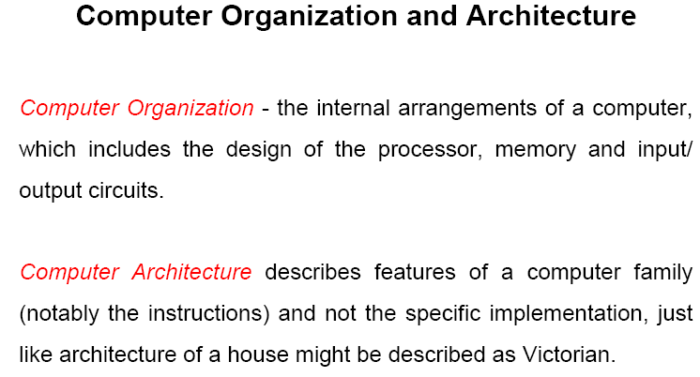

Slide 8
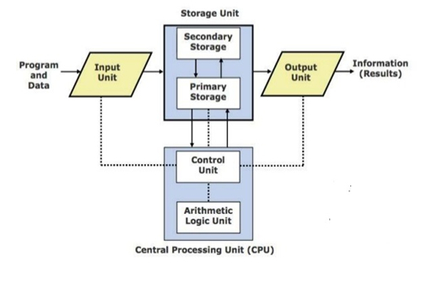
Computer Organization

Slide 9
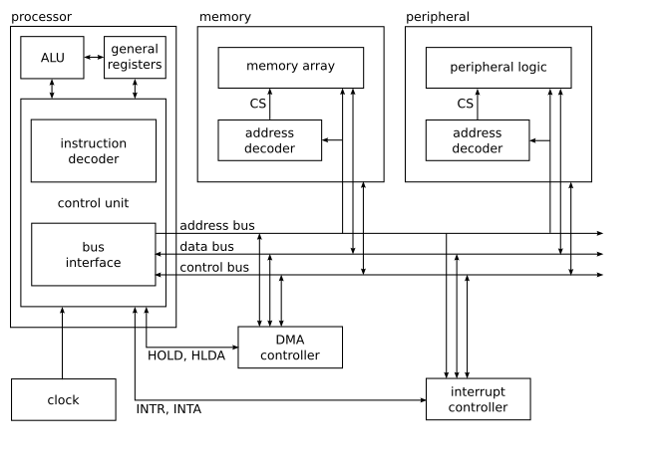
Computer Architecture

Slide 10
Instruction set architecture
the instruction set architecture refers to what the programmer sees as the machine's instruction set. The instruction set is the boundary between the hardware and the software, and most of the decisions concerning the instruction set affect the hardware, and the converse is also true, many hardware decisions may beneficially/adversely affect the instruction set.

Slide 11
Structure & Function
Structure is the way in which components relate to each other
Function is the operation of individual components as part of the structure

Slide 12
Types of computer
Mainframes: large computers that can support very many users while delivering great computing power. It is mainly in mainframes where most of the innovations (both in architecture and in organization) have been made.
Minicomputers: have adopted many of the mainframe techniques, yet being designed to sell for less, satisfying the computing needs for smaller groups of users. It is the minicomputer group that improved at the fastest pace (since 1965 when DEC introduced the first minicomputer, PDP-8), mainly due to the evolution of integrated circuits technology (the first IC appeared in 1958).

Slide 13
Supercomputers: designed for scientific applications, they are the most expensive computers (over one million dollars), processing is usually done in batch mode, for reasons of performance.
Microcomputers: have appeared in the microprocessor era (the first microprocessor, Intel 4004, was introduced in 1971). The term micro refers only to physical dimensions, not to computing performance. A typical microcomputer (either a PC or a workstation) nicely fits on a desk. Microcomputers are a direct product of technological advances: faster CPUs, semiconductor memories, etc. Over the time many of the concepts previously used in mainframes and minicomputers have become common place in microcomputers.

Slide 14
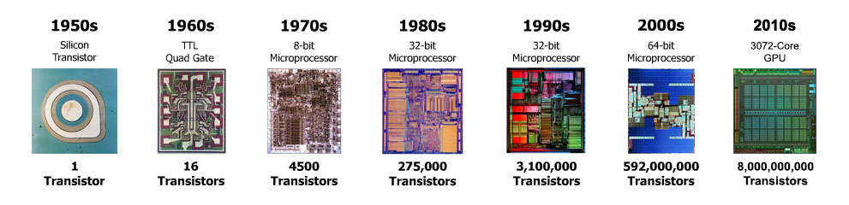
Microprocessors
The microprocessor is nothing but the CPU and it is an essential component of the computer. It is a silicon chip that comprises millions of transistors and other electronic components that process millions of instructions per second. A Microprocessor is a versatile chip, that is combined with memory and special-purpose chips and pre-programmed by a software. It accepts digital data as i/p and processes it according to the instructions stored in the memory. The microprocessor has many functions like functions of data storage, interact with various other devices and other time-related functions. But, the main function is to send and receive the data to make the function of the computer well. This article discusses the types and evolution of microprocessors.

Slide 15
Next Class: Logic gates

